Slide 1
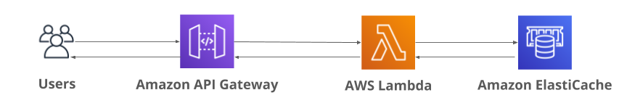
Serverless concept
Serverless is a managed, native cloud architecture that shifts operational responsibility of servers to the cloud. That allows you, the developer, to focus on building applications and services without even thinking about the servers and software needed to run your code.
Cost-efficiency is intertwined with serverless because you only pay for what you use, whereas even virtual servers cost money to run 24/7.
In this lesson, we will use a serverless frontend called API Gateway which will send the request to a Lambda Function, which will serve as our backend.
That Lambda will either set or get the user's name from a managed, in-memory database service. The Lambda will return the name back to the user via the API Gateway.
Intro to Cloud Computing https://classroom.udacity.com/courses/ud080/lessons/6860cb92-05c5-4de6-bba8-679709fb21f0/concepts/3425934a-5c11-4136-b5be-0df48c937f7a

Slide 2
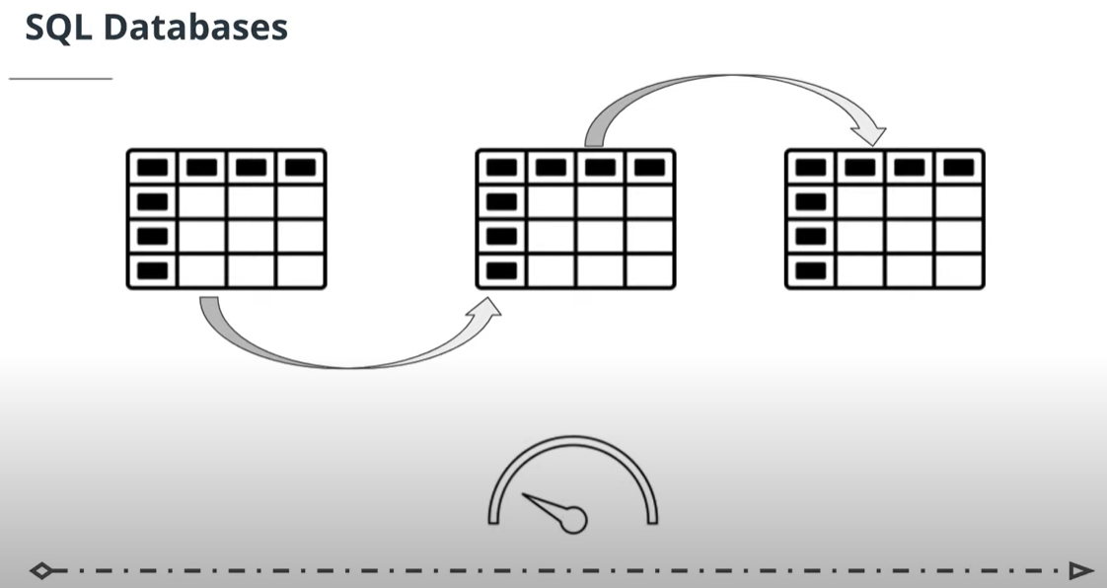
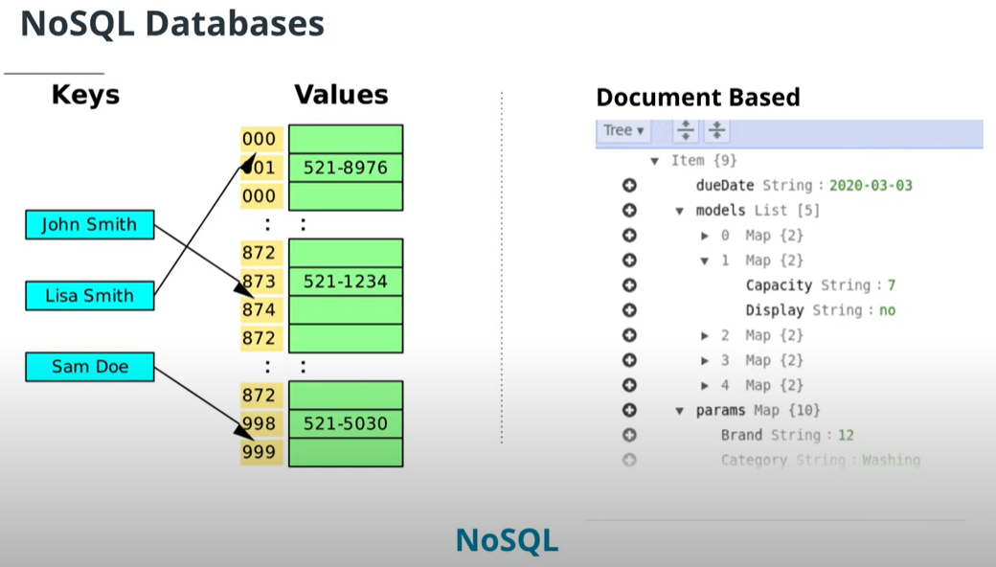
ElastiCache
ElastiCache
Managed, in-memory NoSQL database
For security, instances are deployed to a private subnet by default and lack a publicly reachable address
Redis is an open-source data store, whereas ElastiCache is AWS's proprietary service the hosts Redis databases for AWS users
Great choice for real-time applications such as gaming, chat, and video
Easily scalable and replicable
Rational databases
structured data
Not only SQL databases
flexible data requirements

Slide 3
Exercise: ElastiCache For Redis
In this exercise, you will launch a Redis instance on ElastiCache. You will continue to use this instance in the next exercise.
Instructions
Single node with no replication
t2.micro type
us-east-1 N.Virginia region
Setup on the default VPC
No encryption either in transit (No Auth) or at-rest
Name the node redis

Slide 4
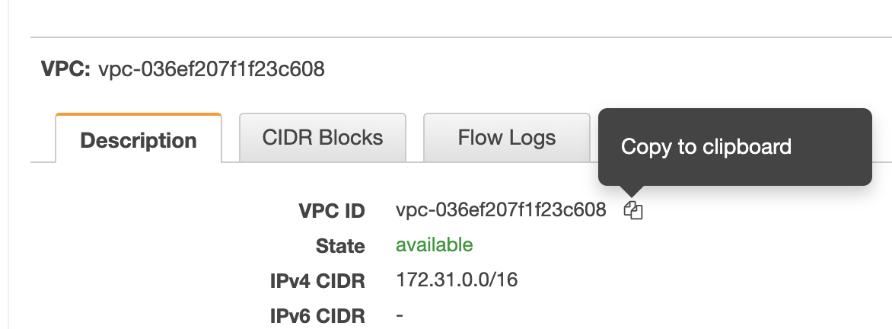
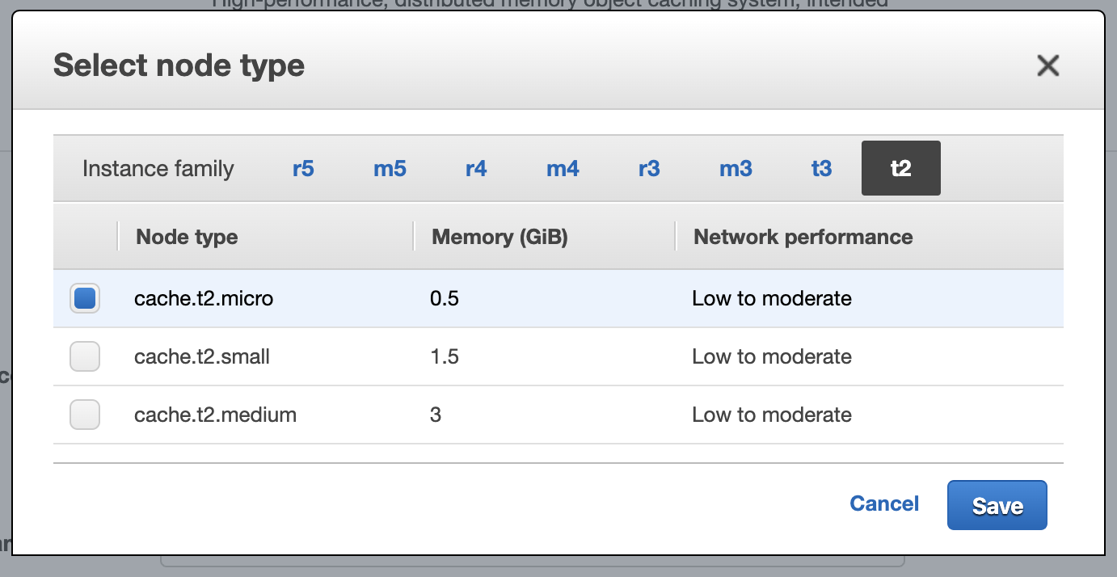
Before you start, you need to get the Virtual Private Cloud ID of the default VPC:
Default VPC ID
Open the VPC console
Note the default VPC ID
Create the ElastiCache Redis Instance
Open the ElastiCacheconsole
Change the region on the top right to be us-east-1 N.Virginia
Click Redis on the sidebar menu, then click the Create button
Name the instance redis
Change the number of replicas to 0
Change the Node type to be t2.micro
Save

Slide 5
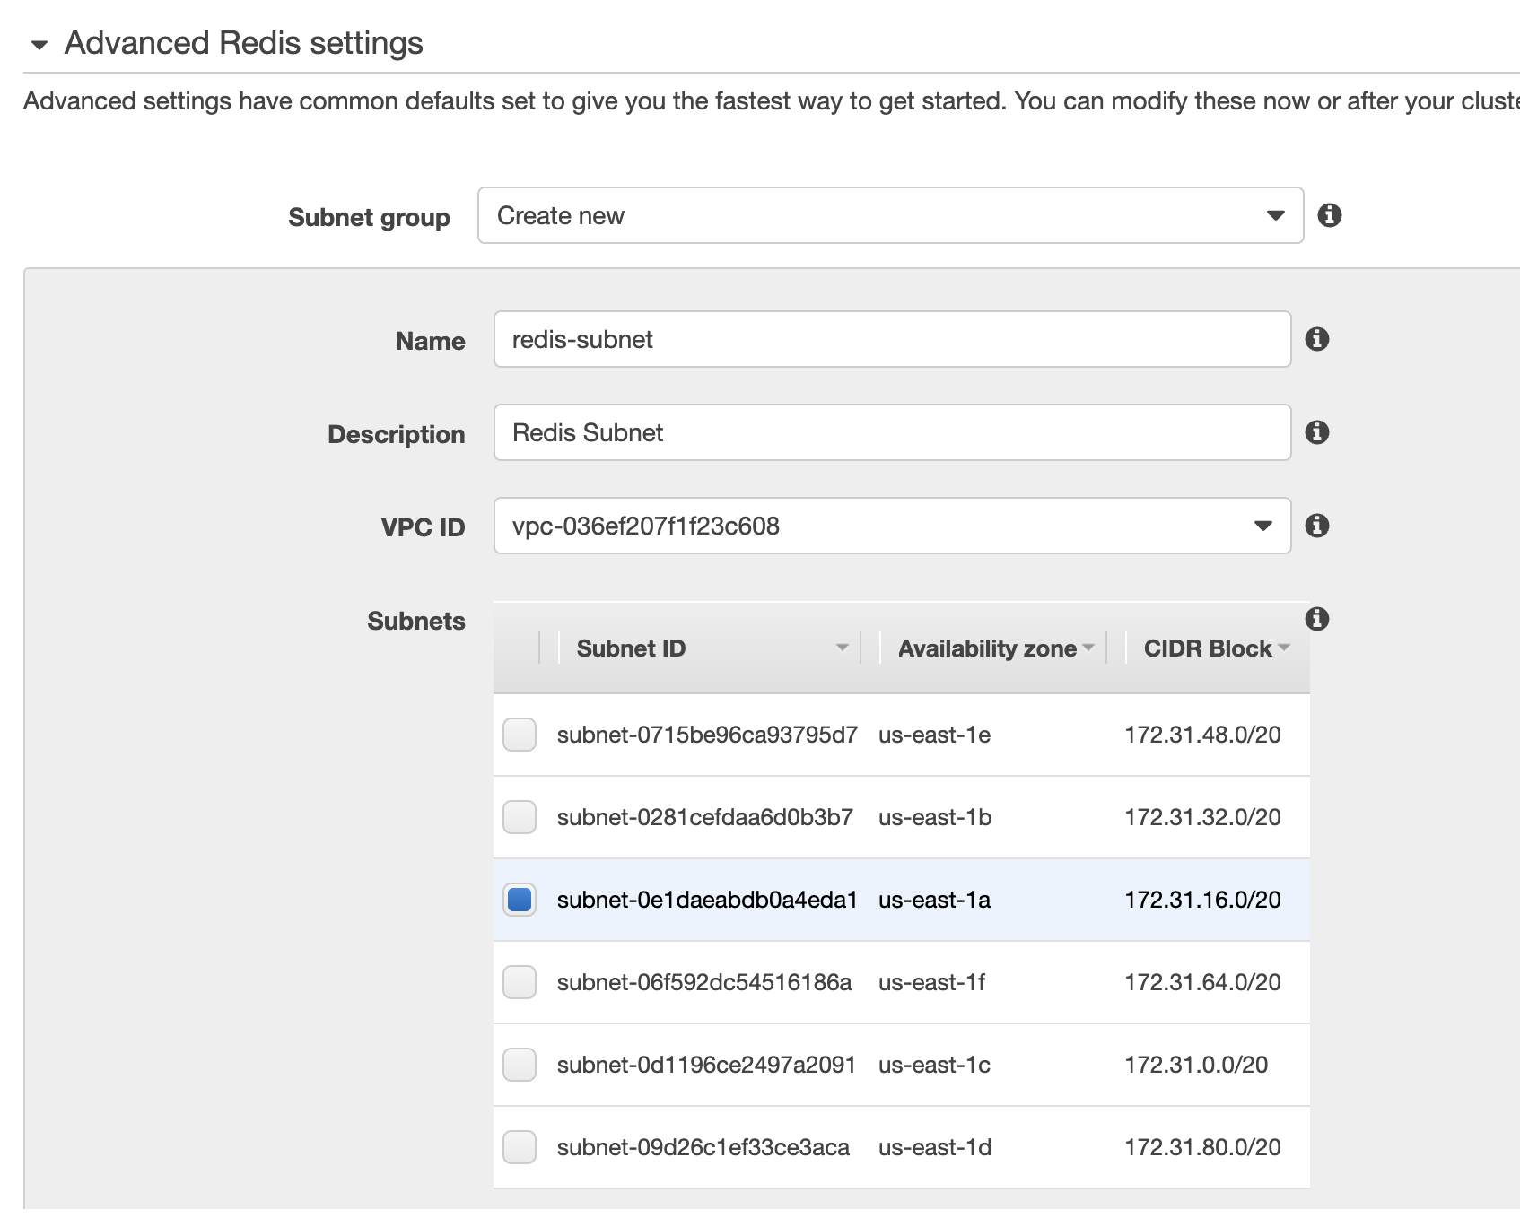
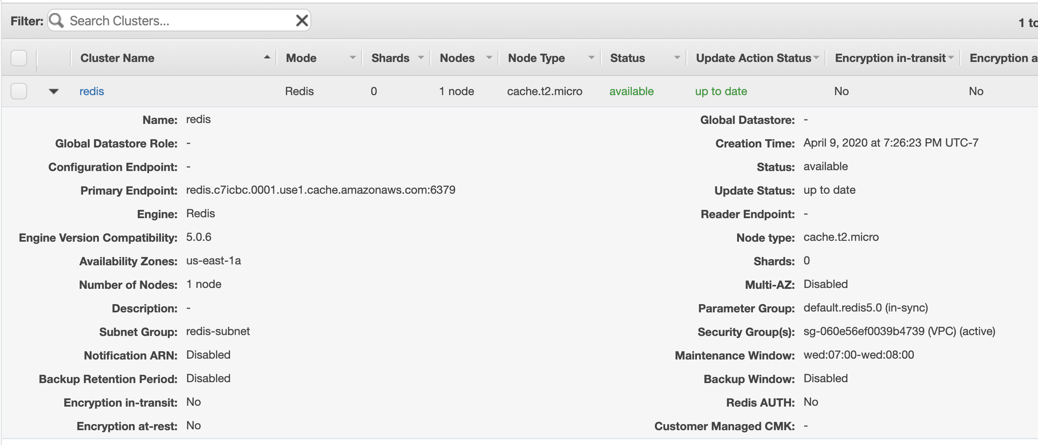
8. Under the Advanced Redis Settings, set the Name to be redis-subnet
9. Set the Description to Redis Subnet
10. Change the VPC ID to the default VPC ID that you noted previously
11. Select us-east-1a as the subnet
12. Scroll down to the Backup section and deselect Enable Automatic backups
13. Click on the Create button
Wait a few minutes for the instance to initialize. You can refresh the dashboard using the refresh arrows icon in the top-right corner of the dashboard.

Slide 6
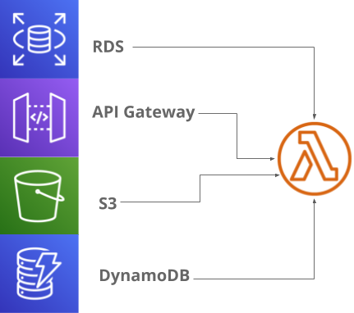
Lambda Function
Serverless fast solution to run code for a task
Write code directly in the AWS console or upload a zip package with dependencies
Supports multiple code languages
Can be tested from the console

Slide 7
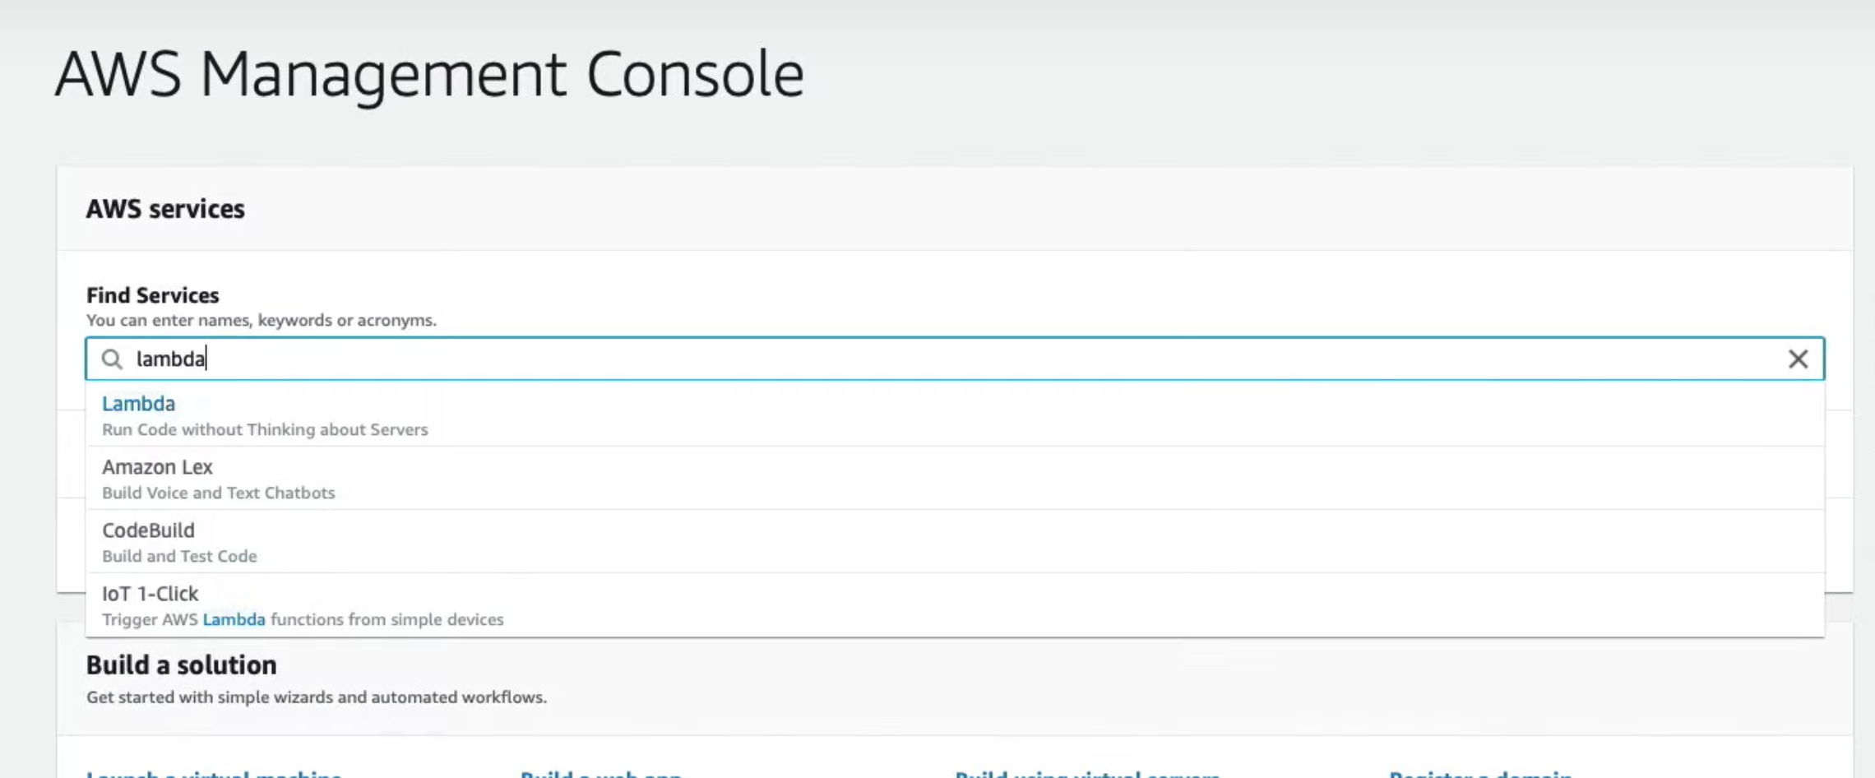
Exercise: Hello from Lambda
In this exercise, you will create a basic Lambda Function.
Instructions
Create a Lambda Function from scratch
The Lambda Handler should be set to the default lambda_function.lambda_handler
Manually trigger the Lambda via a test event and verify the message "Hello from Lambda“
1. Navigate to the Lambda Console by searching for Lambda under Find Services

Slide 8
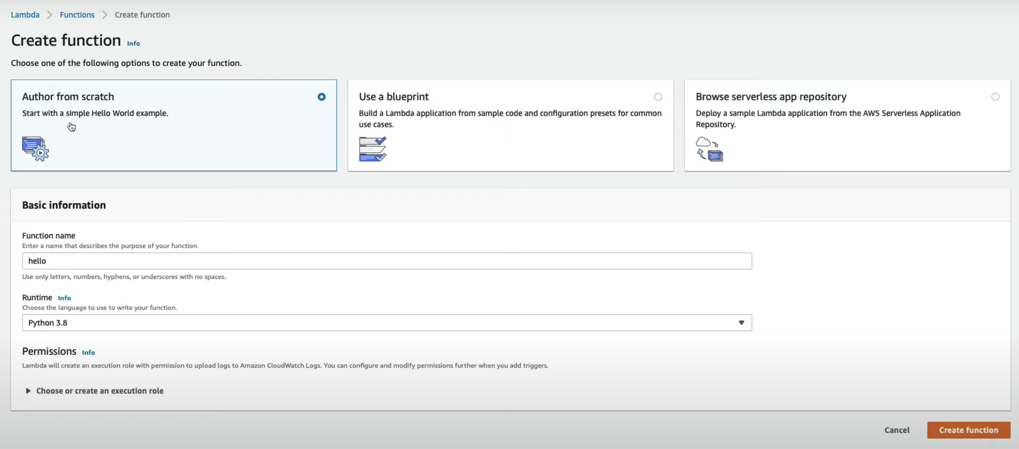
2. Click the Create function button and select Author from scratch
3. Name the function hello
4. Set the runtime to Python3.8
5. Click the Create Function button

Slide 9
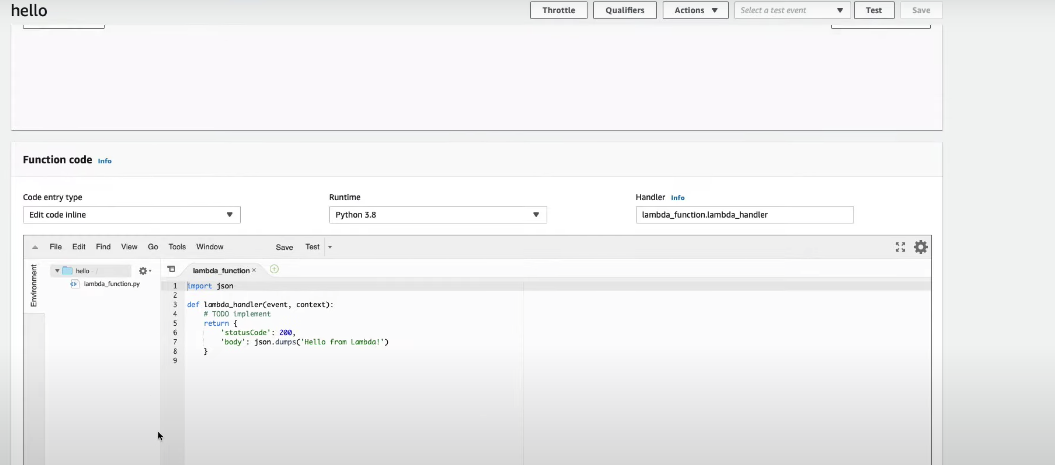
6. Notice the handler field on the embedded code page. It's format is file-name.function-name. In our case, the file name is lambda_function.py and the code function name is lambda_handler, which is why the handler is pre-set to lambda_function.lambda_handler.

Slide 10
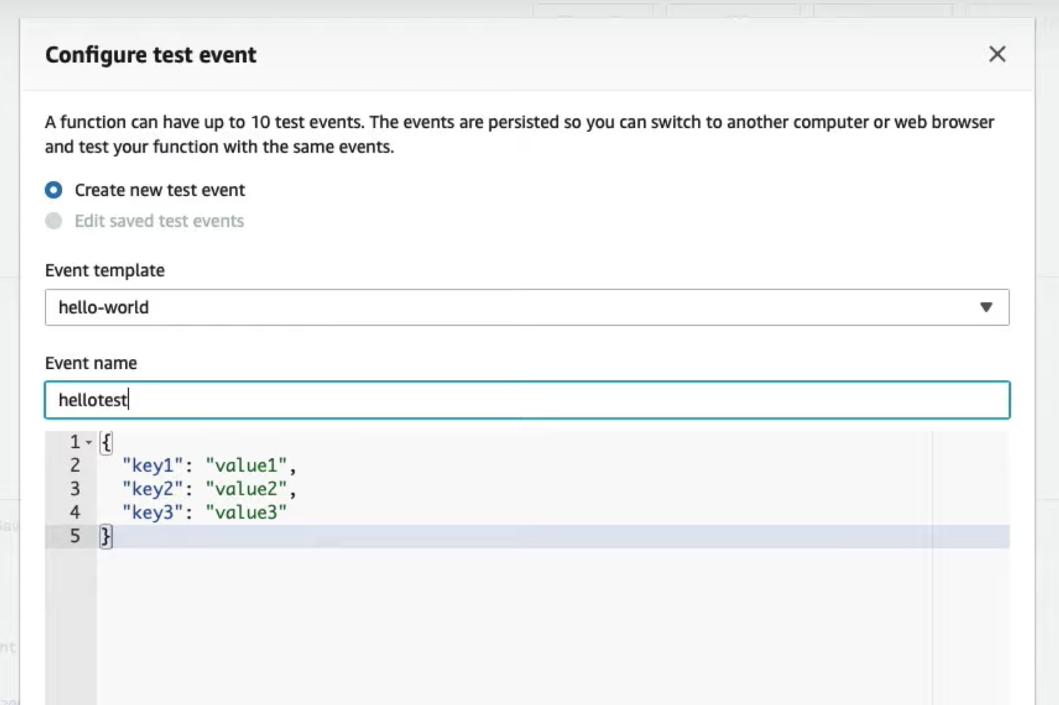
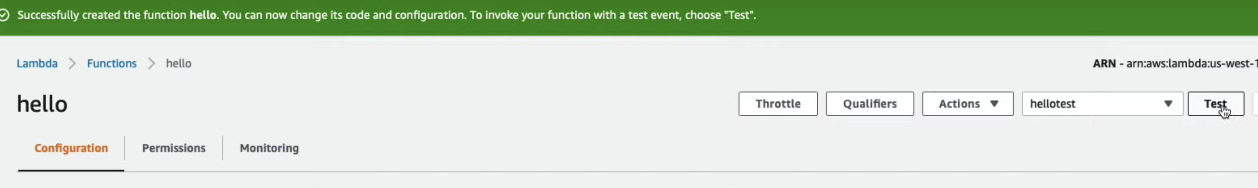
7. Click on the Test button and configure a test event.
8. Name the event hellotest and save the event.
9. Click the Test button again while the hellotest event is pre-selected

Slide 11
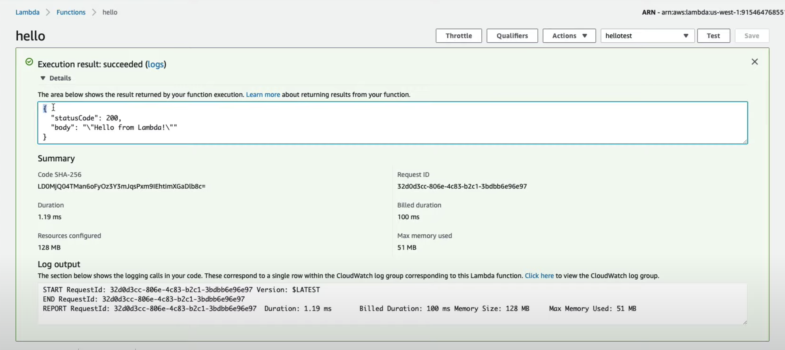
10. Expand the Execution result
11. Verity the message: "Hello From Lambda!"

Slide 12
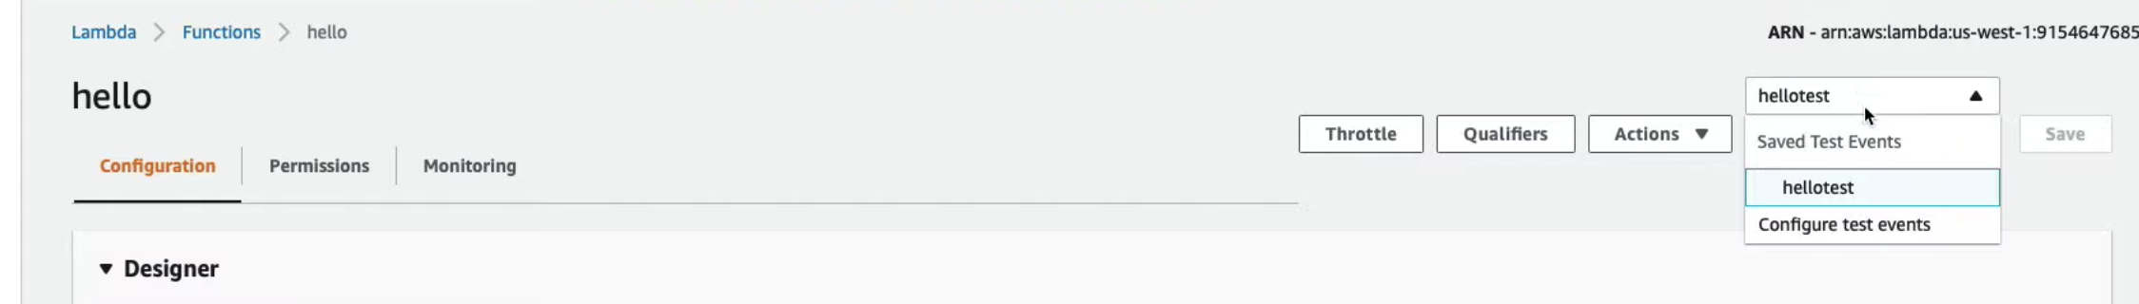
Exercise: Lambda Events
Modify the testhello event for the Lambda with the existing field:
{“user”: “Udacity”}
Modify the Lambda Function code to read the user out of the event field and display “Udacity”.
1. From the hello Lambda Function, click on the hellotest dropdown menu and select Configure test events

Slide 13
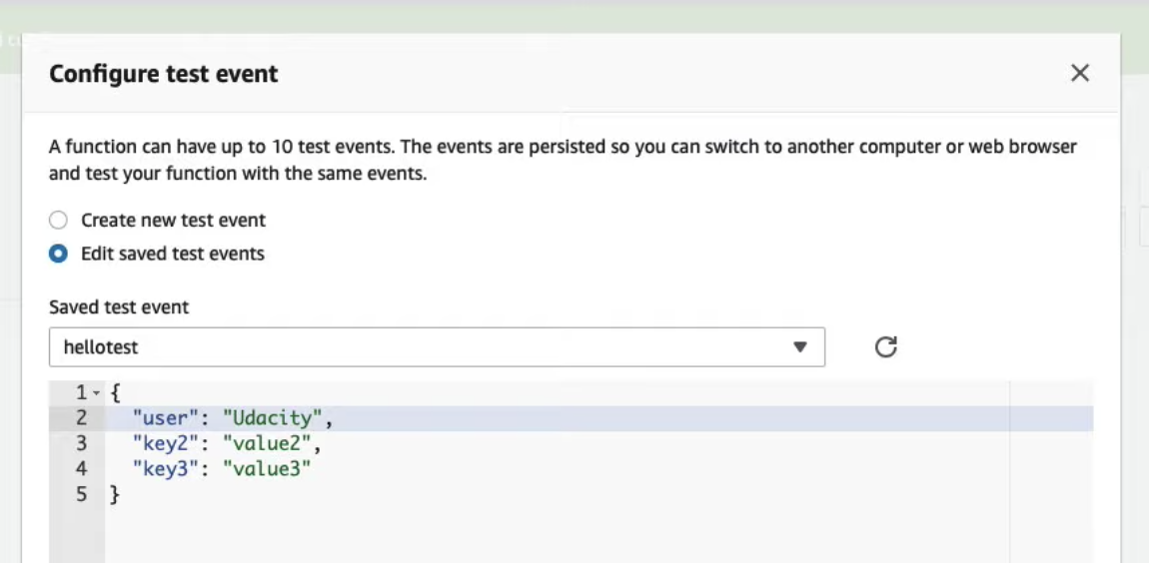
2. Select Edit saved test events option (it should be pre-selected already)
3. Change key1 to be "user"
4. Change the value for "user" to be "Udacity"
5. Click Save Event
6. Edit the code in the editor and set the body on line 7 to be:
json.dumps(event["user"])

Slide 14
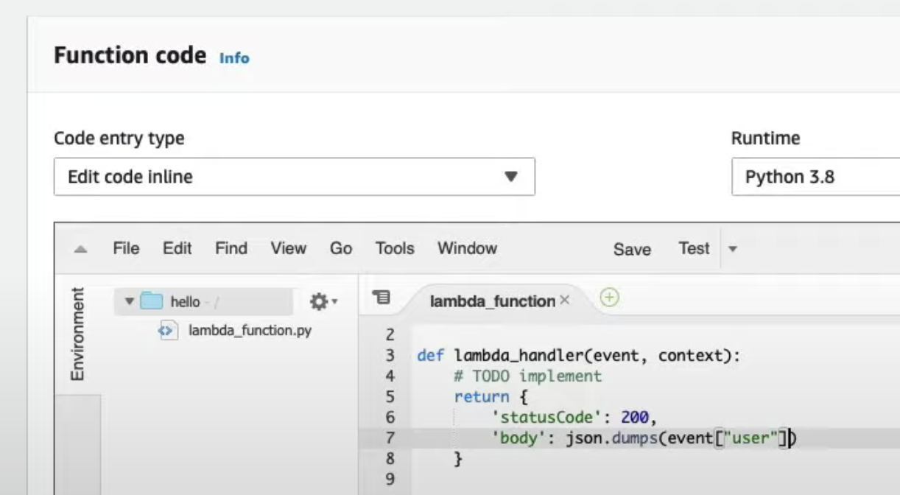
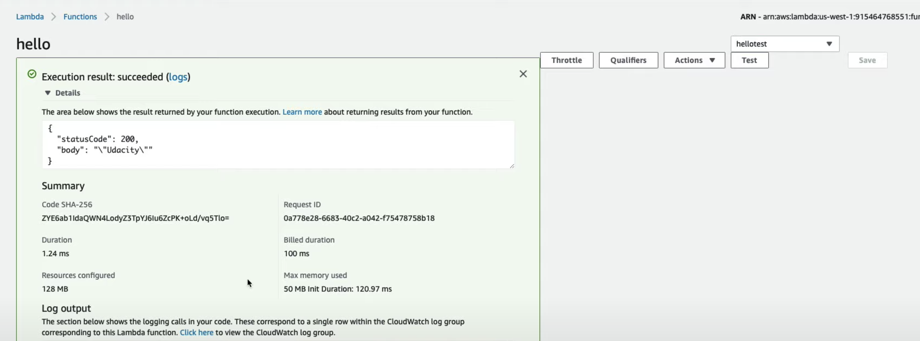
7. Click Save.
8. Click the Test button.
9. Expand the results.
10. Verify message: Udacity

Slide 15
Exercise: Packaging Code For Lambda Deployment
In this exercise, you will prepare a package for a Lambda deployment. Your code will include both the Lambda Function code and the Redis dependency.
Prerequisites
To complete this exercise, you will need:
Python3
pip
Instructions
Install the Redis dependency into the package folder
  Hint: use pip install --target
Zip the folder

Slide 16
Code to include as main.py
import redis
import os
import json
def handler(event, context):
print("Received event: " + json.dumps(event, indent=2))
redis_host = os.environ.get("REDIS_HOST")
redis_port = 6379
redis_password = ""
r = redis.StrictRedis(
host=redis_host,
port=redis_port,
password=redis_password,
decode_responses=True
)
name = event.get("name")
if event.get("body"):
name = json.loads(event["body"]).get("name")
if name:
redis_successful_set = r.set("name", name)
if redis_successful_set:
return {
"statusCode": 200,
"body": "Success! {name} was written to Redis".format(name=name.capitalize())
}
else:
return {
"statusCode": 500,
"body": "Oops! Could not write {name} to Redis".format(name=name.capitalize())
}
return {
"statusCode": 200,
"body": "Hello {name} nice to meet you".format(name=r.get("name").capitalize())
}

Slide 17
Prerequisites
To complete this exercise solution, you will need:
Python3 installed
Create the Lambda Package
For this section, you will need to have Python3 installed.
Lambda Functions are triggered by events. When our Lambda Function is triggered, our function will check if the event has a "name" field. if the even has a "name" field, our function will store the name in Redis. If the event does not have a name field, our function will fetch the name set in Redis.
1. Create a new folder on your computer called hello
2. Create a new file called main.py inside the hello folder
3. Copy the code into the main.py file (see code on previous slide).
4. Use the following command to install the code dependencies into a folder called package
pip3 install --target ./package Redis
5. Create a ZIP archive of the dependencies using the following command
~hello$ cd package
~hello/package$ zip -r9 ../function.zip .
6. Add your function code to the archive
~/hello/package$ cd ..
~/hello$ zip -g function.zip main.py

Slide 18
Exercise: Uploading a Lambda Function
In this exercise, you will upload a code package to Lambda.
Prerequisites
If you have not already done so, complete the previous exercises to create a code package (zip file).

Slide 19
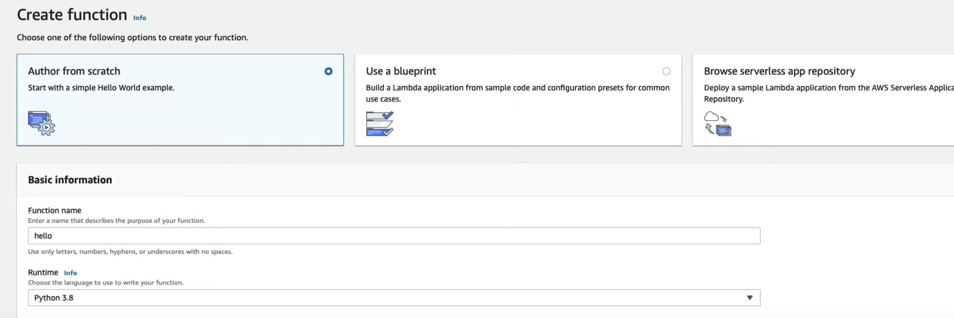
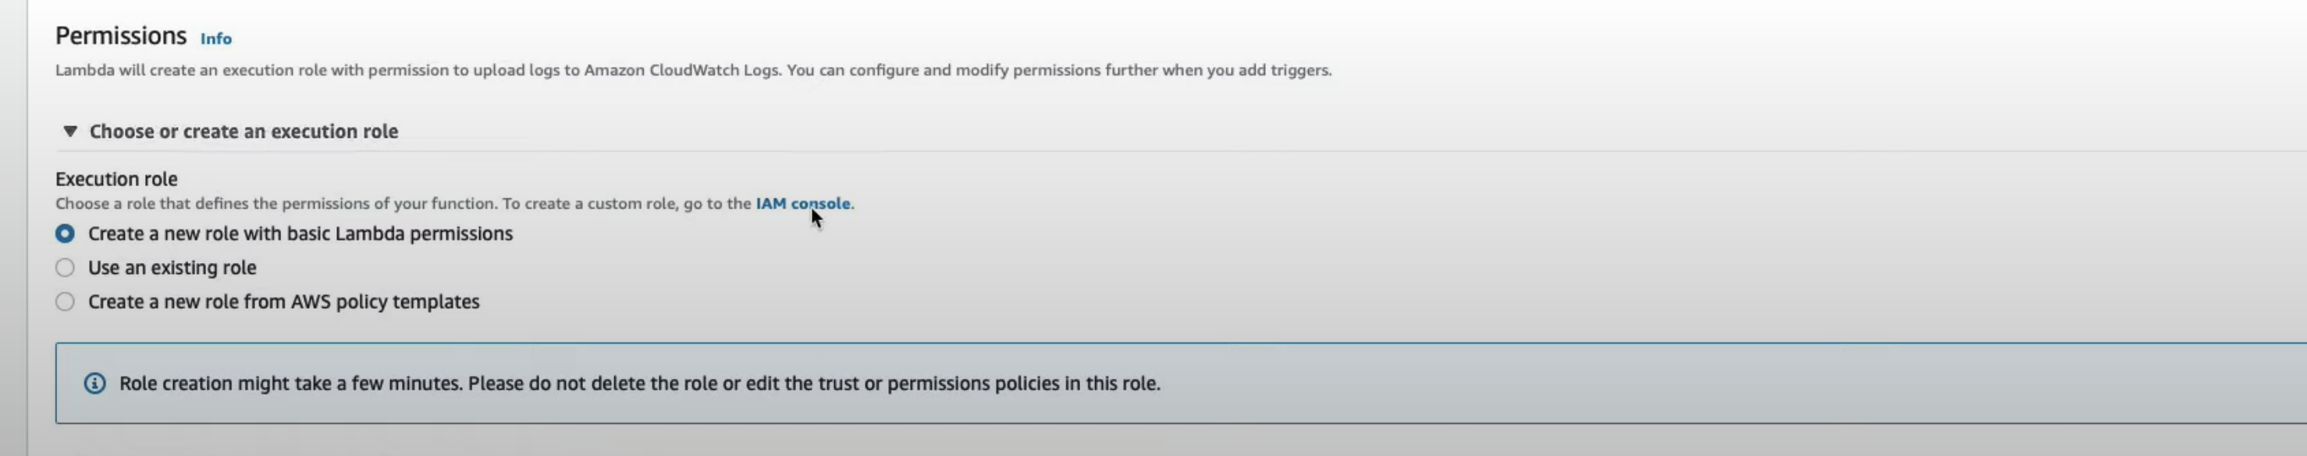
Navigate to the Lambda Console
Create a new Lambda Function
Use Author from scratch, Python3.8, and name the function hello
4. Expand the permissions section
5. Click the IAM Console link

Slide 20
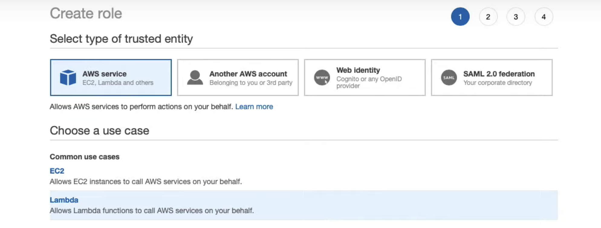
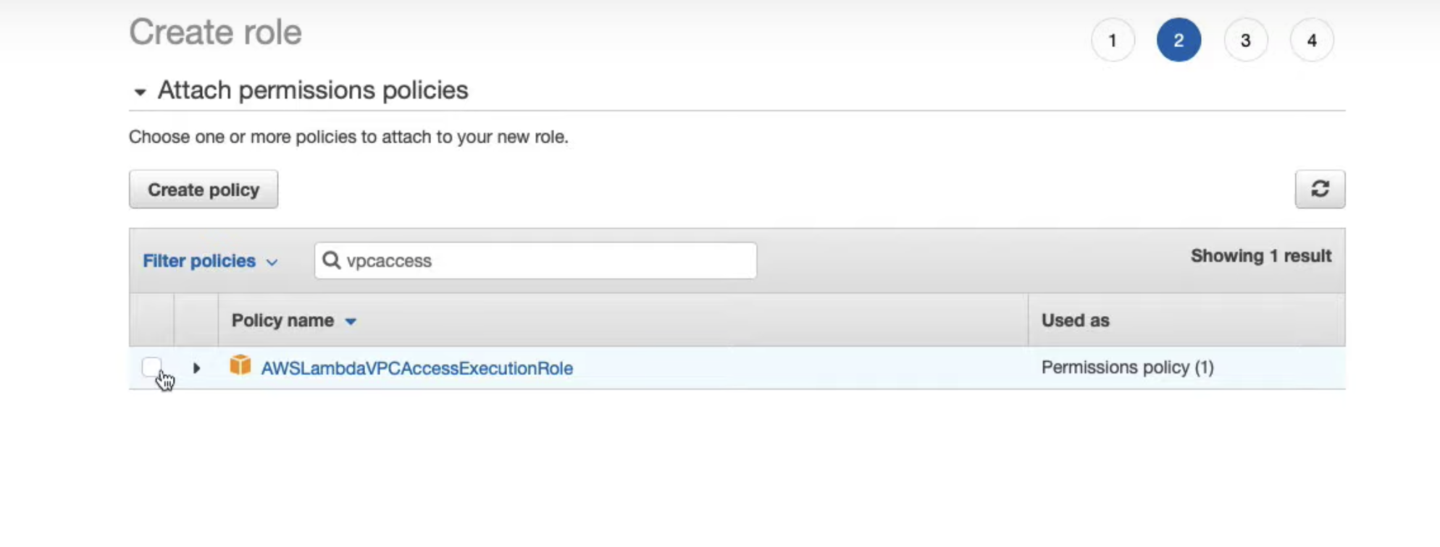
6. Click on Roles from the left sidebar
7. Create a new role
8. Set the type of trust identity to Lambda
9. Attach the built-in policy: "AWSLambdaVPCAccessExecutionRole"

Slide 21
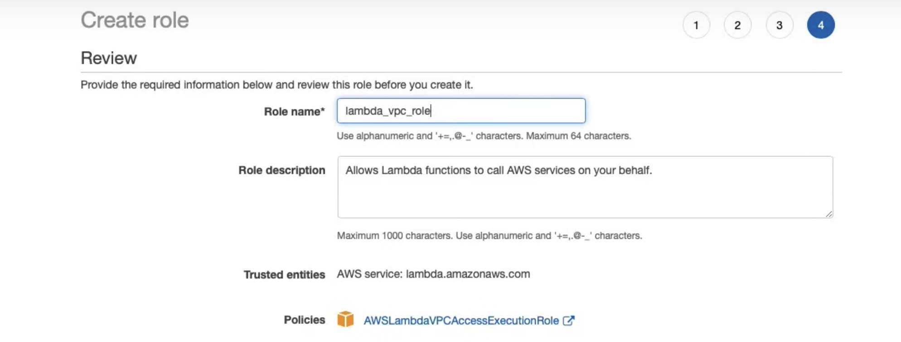
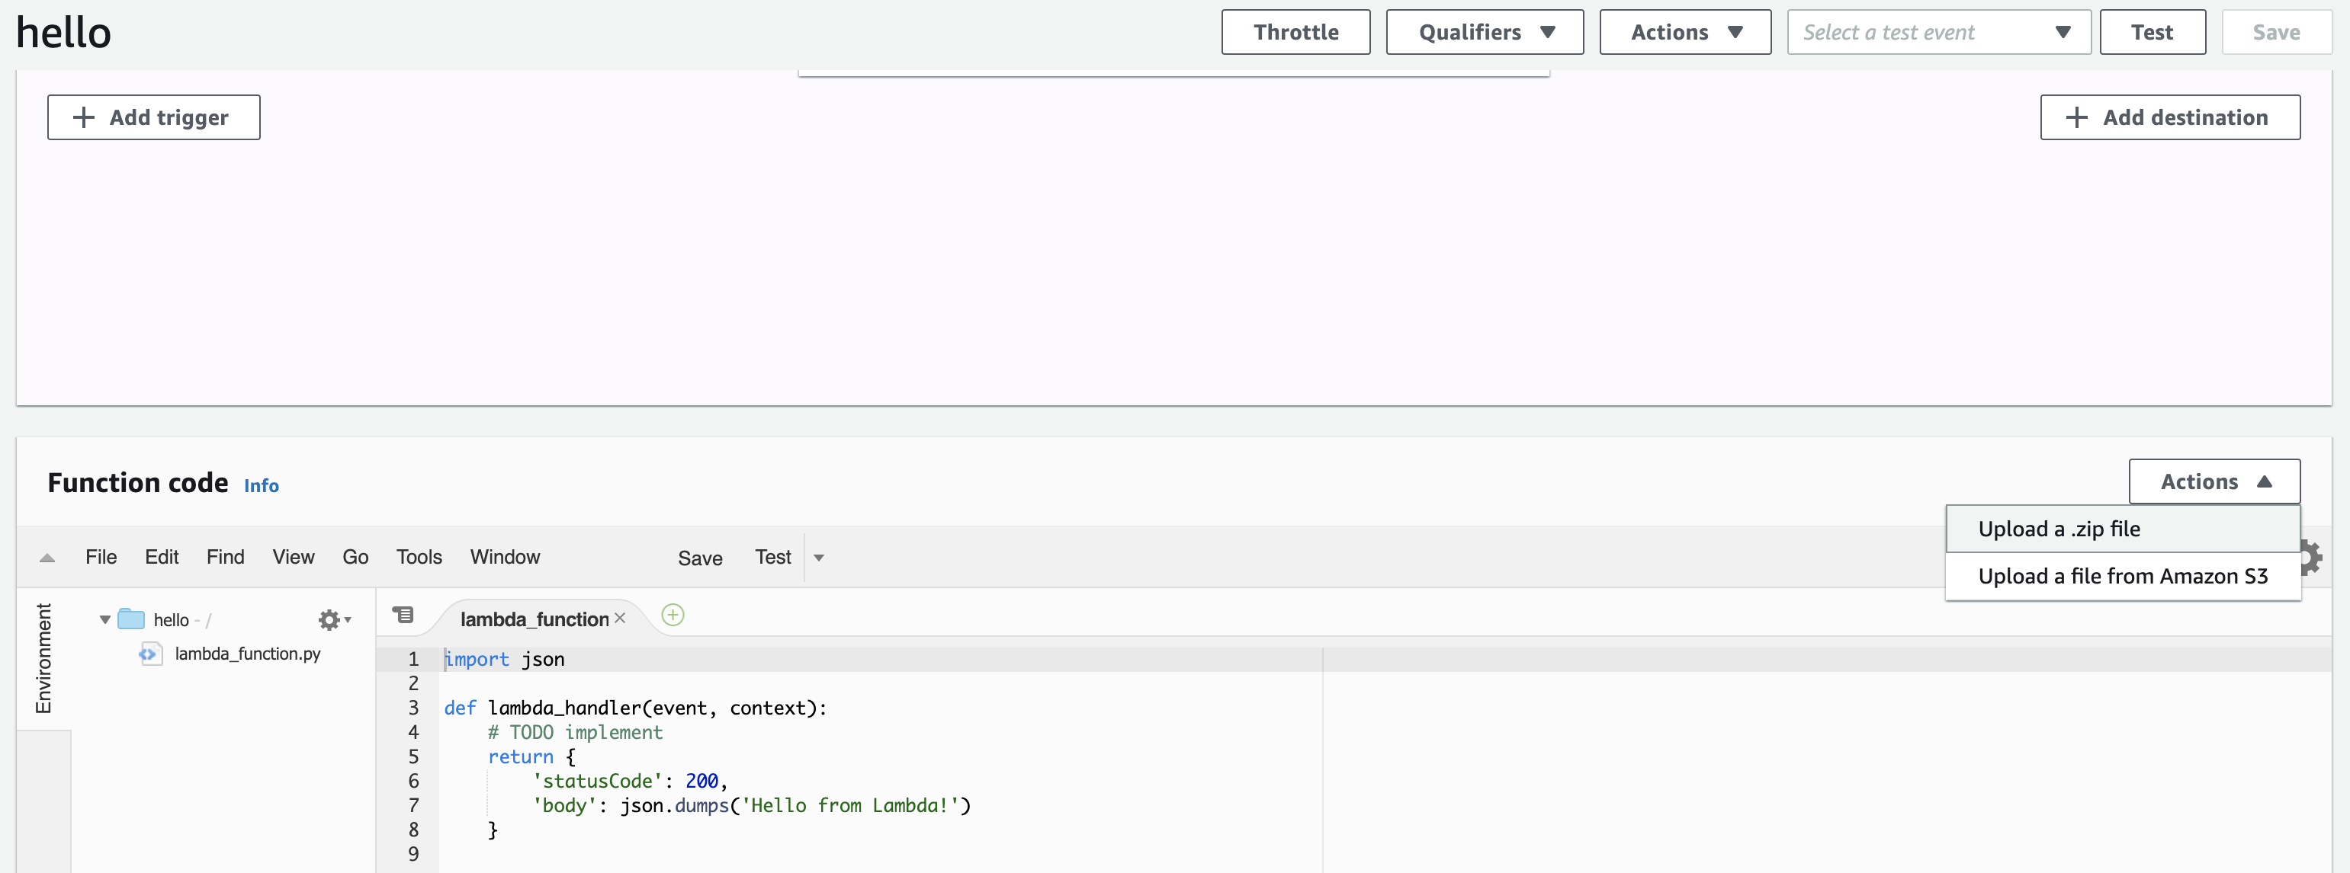
10. Name the role lambda_vpc_role
11. Click the Actions drop-down menu from the Function code section of the Lamba Function Console
12. Select Upload a .zip file

Slide 22
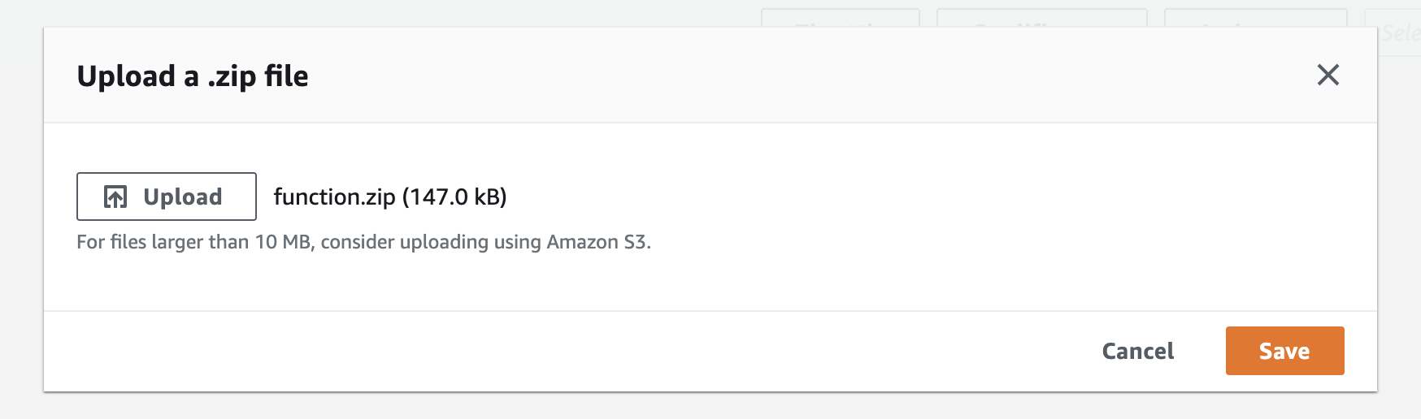
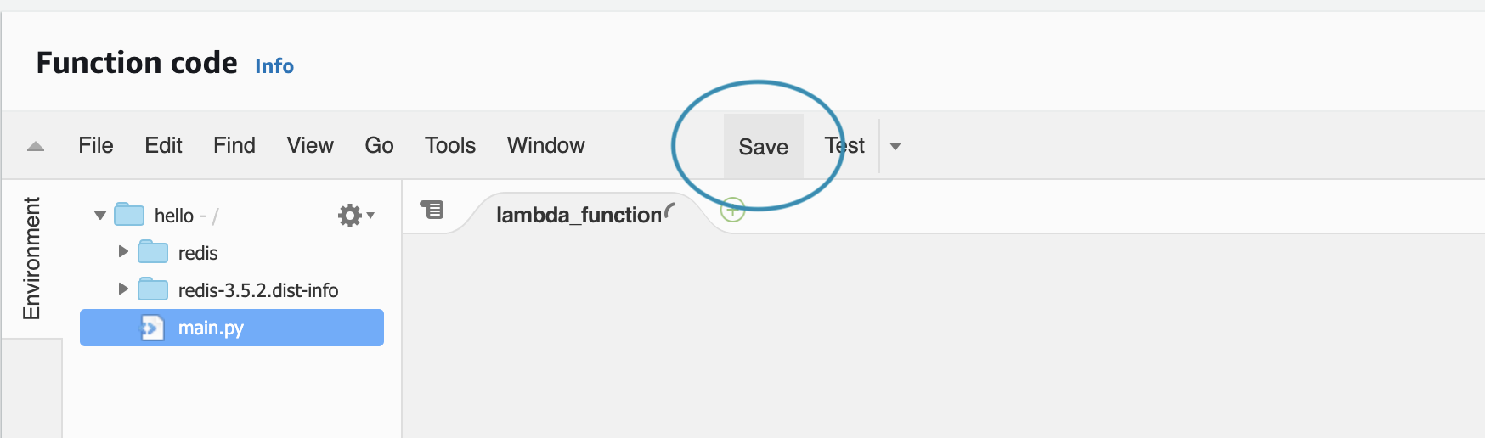
13. Select the function.zip package created in the previous exercise
Once selected, you MUST click Save

Slide 23
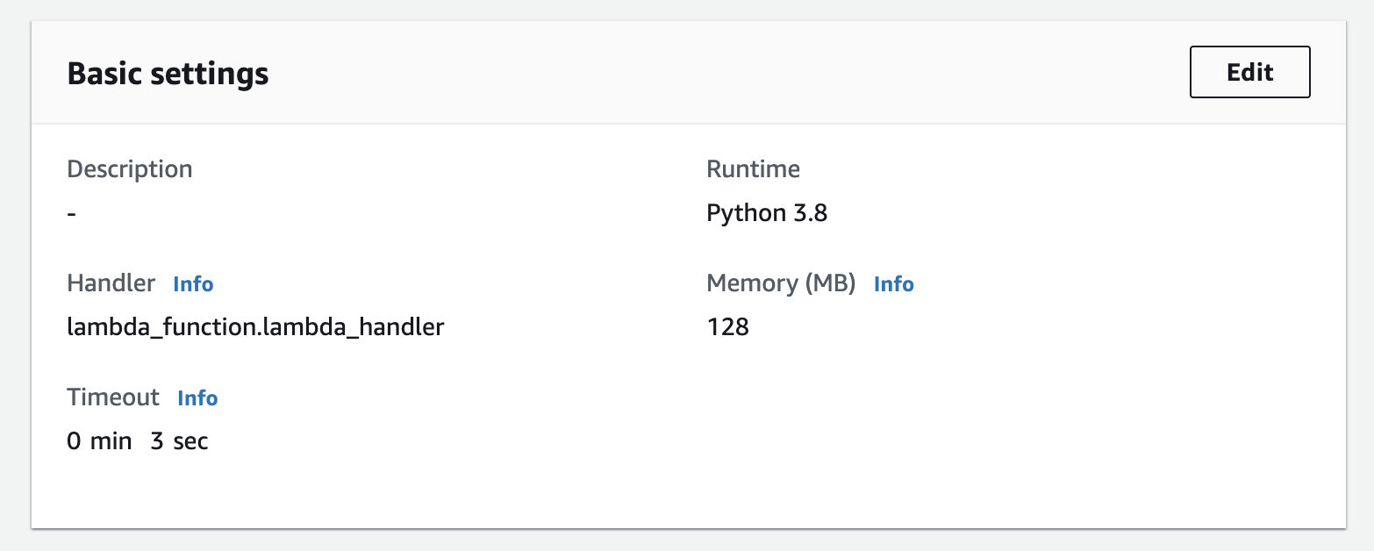
14. Scroll down to the Basic settings section
15. Click the Edit button

Slide 24
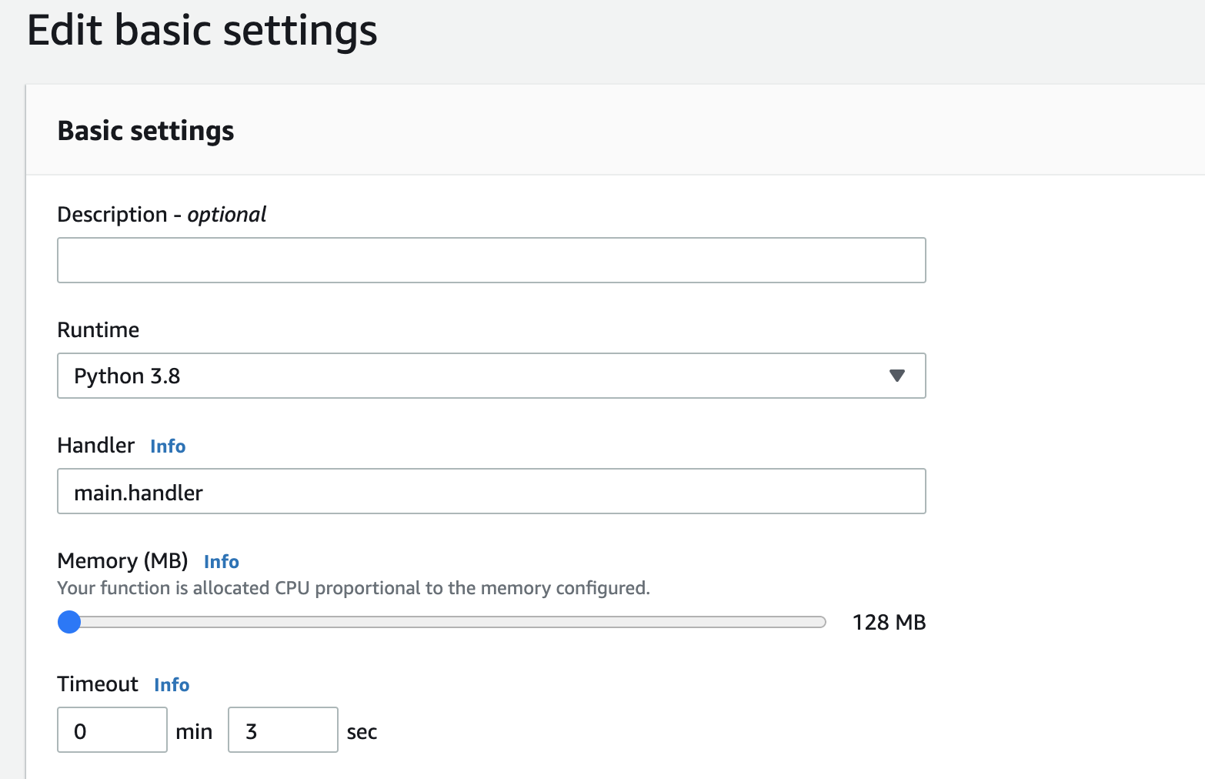
16. Set the Handler field to main.handler

Slide 25
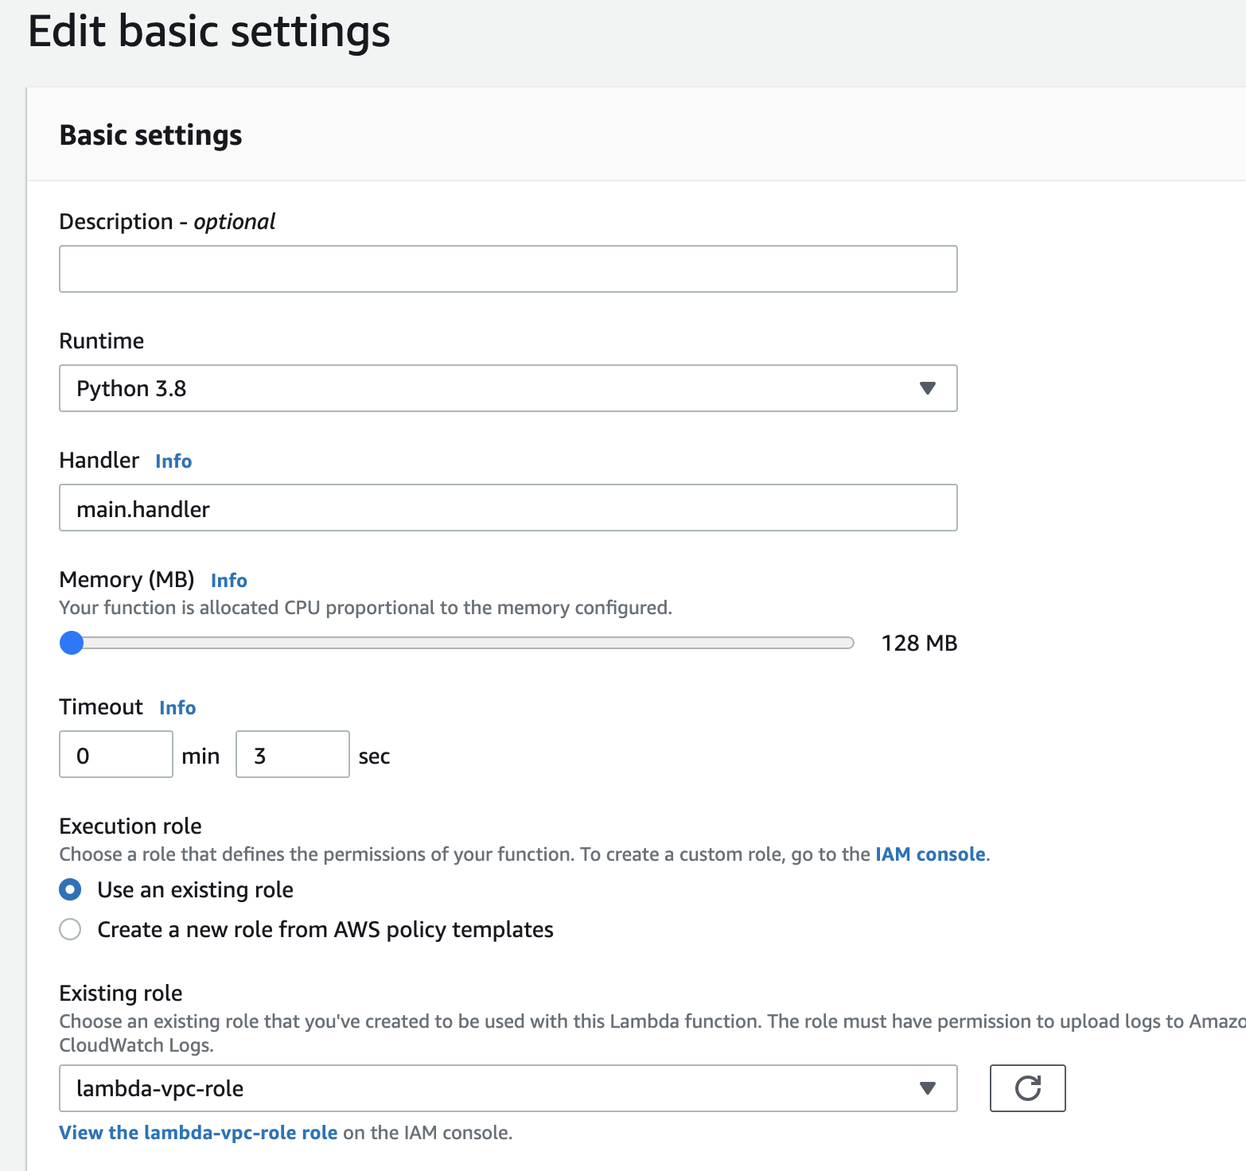
17. Select Use an existing role
18. Select lambda-vpc-role from the drop-down menu of existing roles

Slide 26
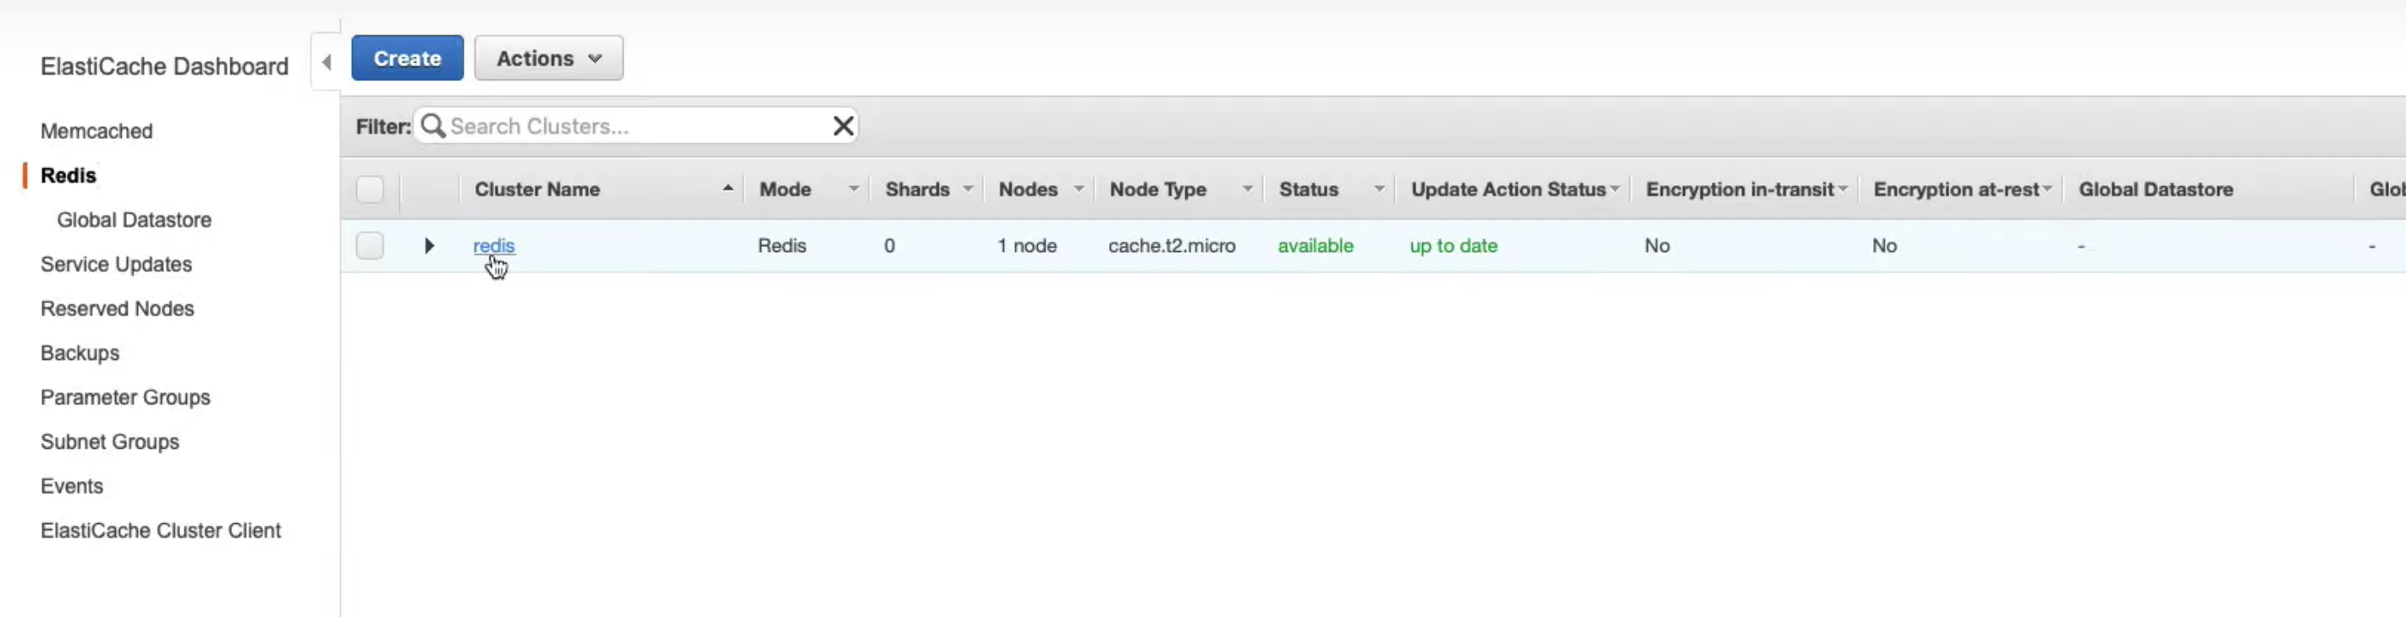
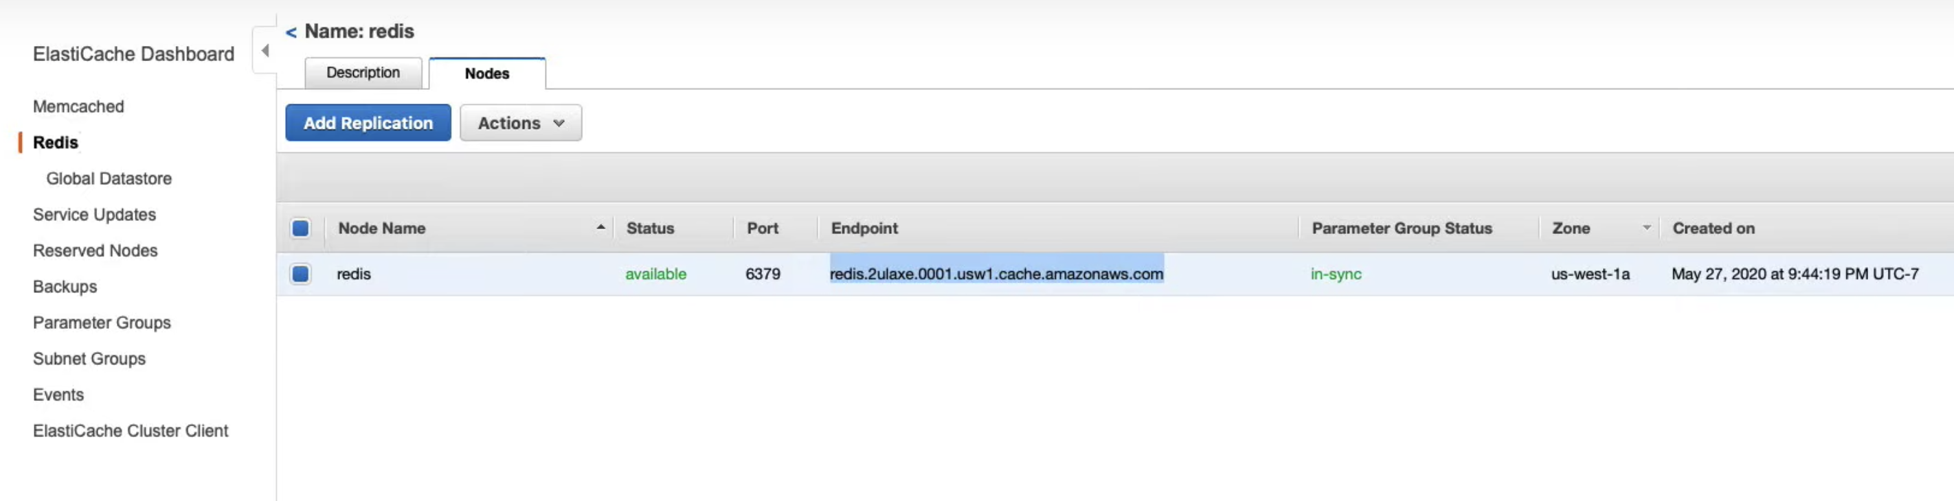
Setting the REDIS_HOST Environment Variable
In another tab, open the ElastiCacheConsole
Expand the "redis" node
Copy the node's endpoint

Slide 27
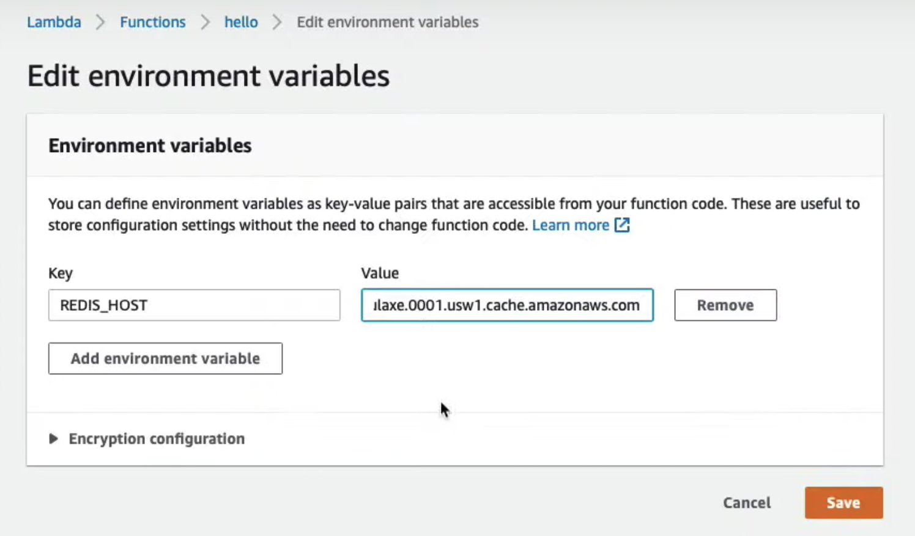
4. Click the Edit button in the Environment Variables section
5. Set the key to REDIS_HOST and paste the node endpoint as the value

Slide 28
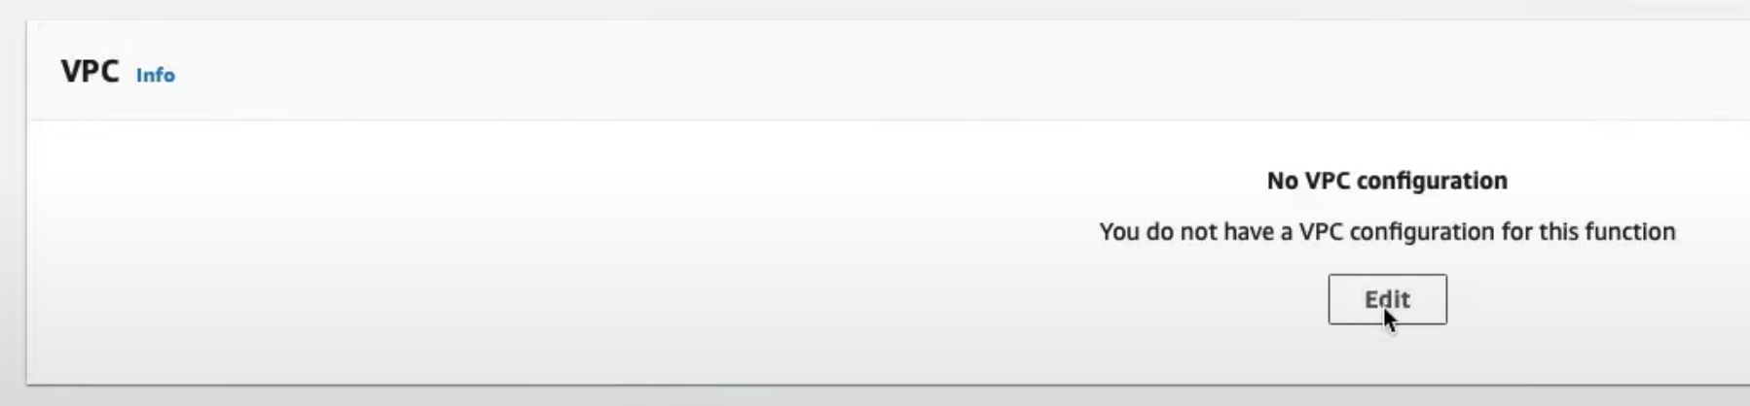
Connect The Lambda to the ElastiCache Redis Network
Click on the Edit button on the VPC section
Select Custom VPC and select the default vpc
Select all the subnets under Subnets
Under the Security groups select the (default) security group - this enables the Lambda to access the ElastiCache for Redis
Click Save

Slide 29
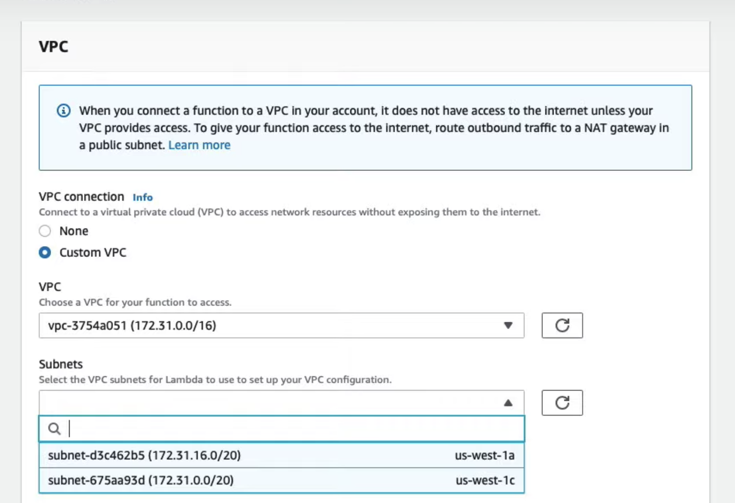
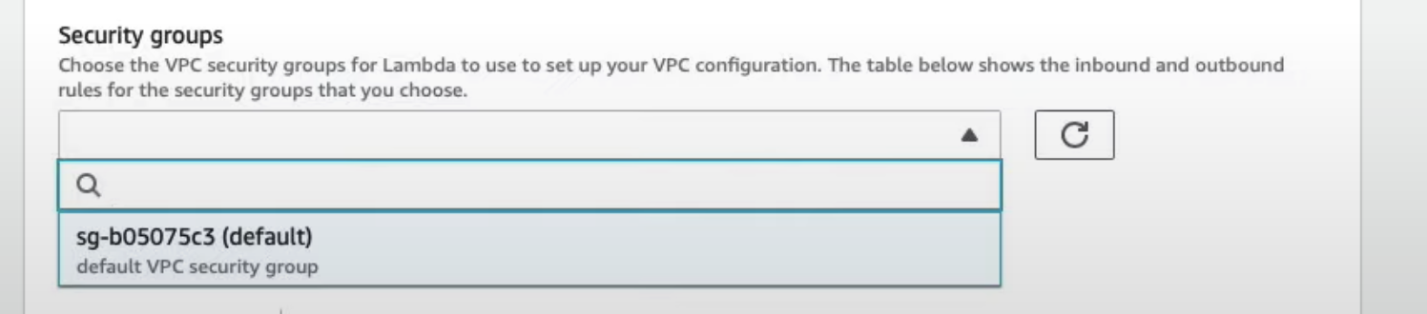
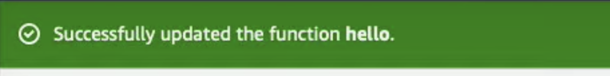

Slide 30
Exercise: Testing Lambda
Configure a test event with:
{ "name": "John Doe"}
Test and review the log to ensure name creation is successful
Create a blank event {} to test for reading the name from Redis
Verify by reading the logs

Slide 31
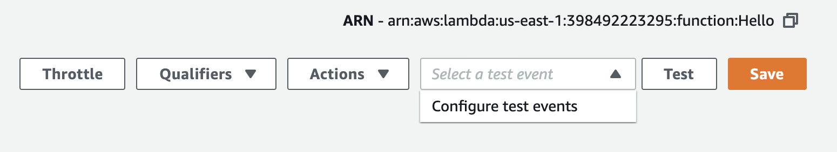
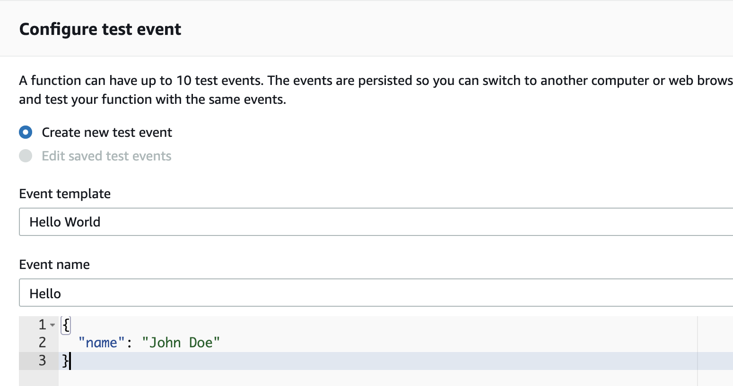
Configuring Lambda Test Event
Configure a new test event
2. Set the event name to Hello
3. Set the content to be
{ "name": "John Doe"}

Slide 32
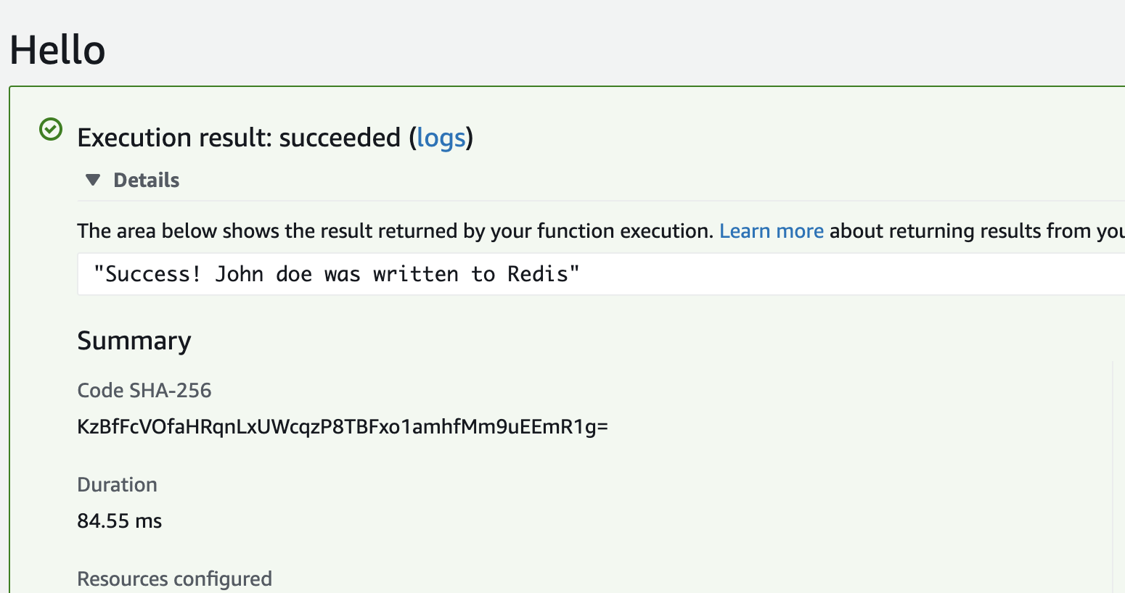
While Hello is selected next to the Test button, click on the Test button to invoke the lambda

Slide 33

Now let's invoke it with an empty event
Configure a new test event with the name Empty and the content {}
Click on Test again, to see the message "Hello John doe nice to meet you"
Feel free to test it again using a different name.
Note: do not delete the Redis instance and Lambda until the end of this lesson exercises

Slide 34
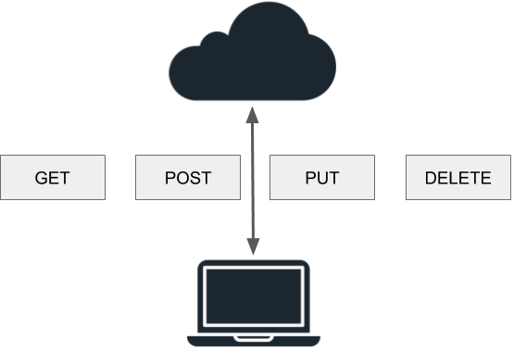
API Gateway
API Gateway is a serverless HTTP app that can connect with a backend Lambda
The simplest way to configure API Gateway is via the Lambda itself, as a trigger
API Gateway can include API keys for additional security or it can be open to the world
The Lambda event is wrapped inside a body field and sent as a JSON string that must be parsed by the Lambda Function

Slide 35
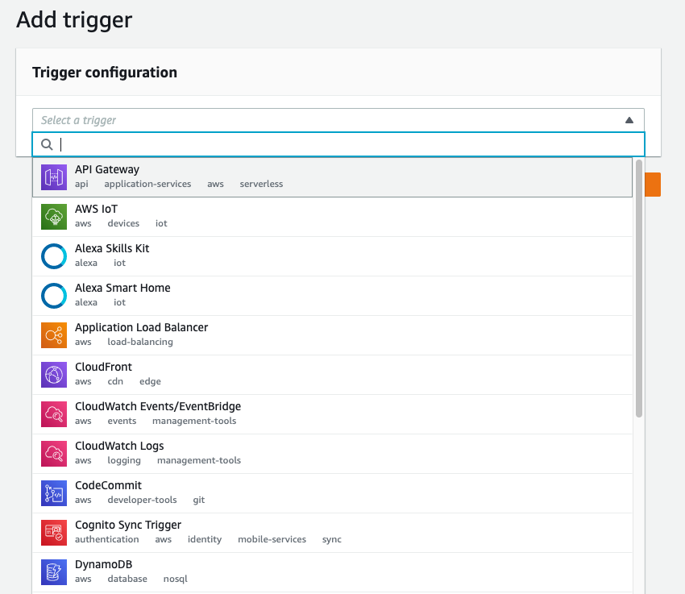
Exercise: API Gateway
In this exercise solution, you connect Lambda with API Gateway via a trigger.
Create the API Gateway Trigger
From the Designer section of the hello Lambda Function console, click the Add trigger button
Select API Gateway from the trigger configuration list

Slide 36
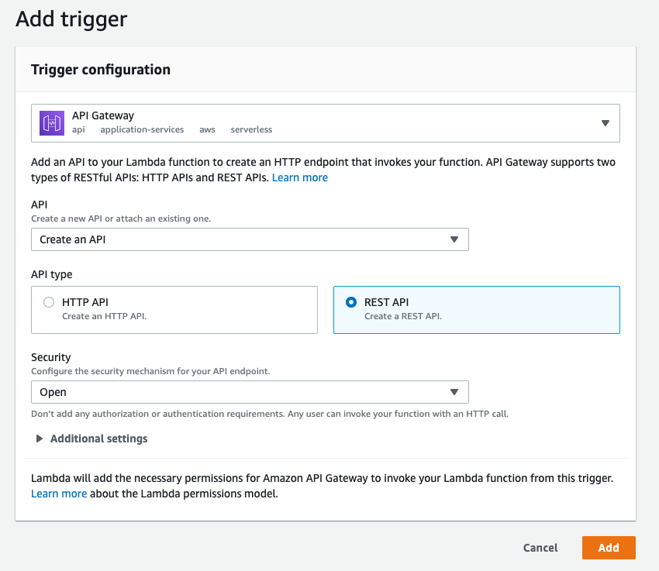
3. Select Create a new API
4. Select the REST API option
5. Choose Open for the Security field
6. Click the Add button

Slide 37
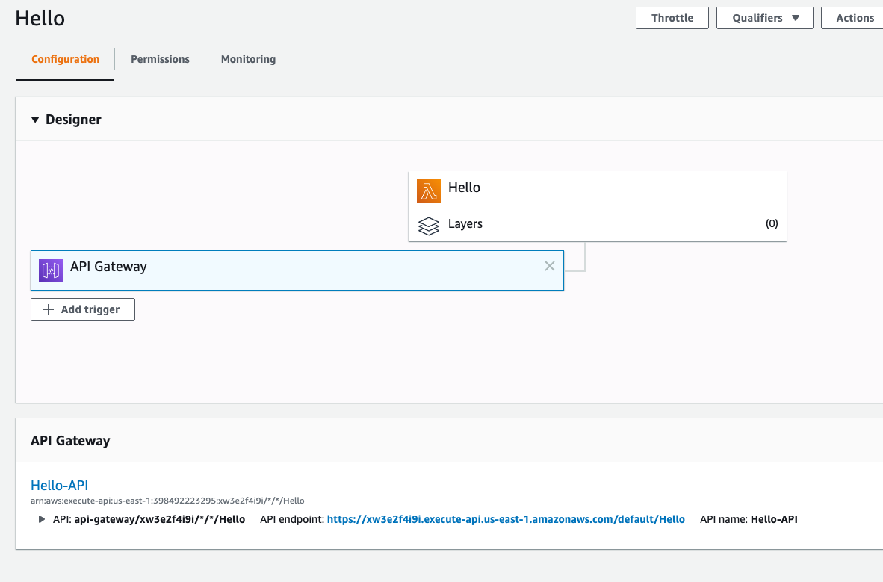
if we click on the API endpoint URL, we should see the "Hello" message from our hello Lambda Function.

Slide 38
Exercise: Postman
Instructions
Download PostMan
Run the downloaded Postman application
Send a POST request to the API Gateway URL for the hello Lambda Function
  Update the request body to store a name in ElasticCache Redis
Test the API Gateway URL with a GET request to verify that the correct name is returned
RESTful (REpresentational State Transfer) APIs (Application Programming Interface) support actions such as create, read, update, and delete (CRUD). Often these actions are implemented by HTTP methods (e.g. POST, GET, PUT, DELETE).

Slide 39
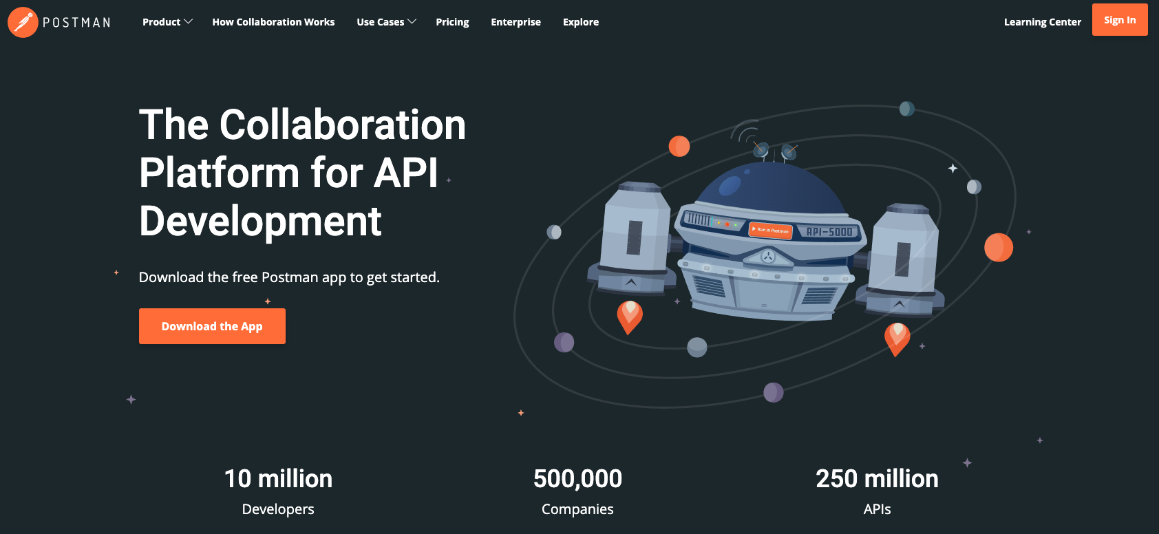
These HTTP methods are supported by web browsers, but web browsers are designed primarily to send GET requests to fetch webpage. Postman makes it easy to send any type of request, with any type of data.

Slide 40
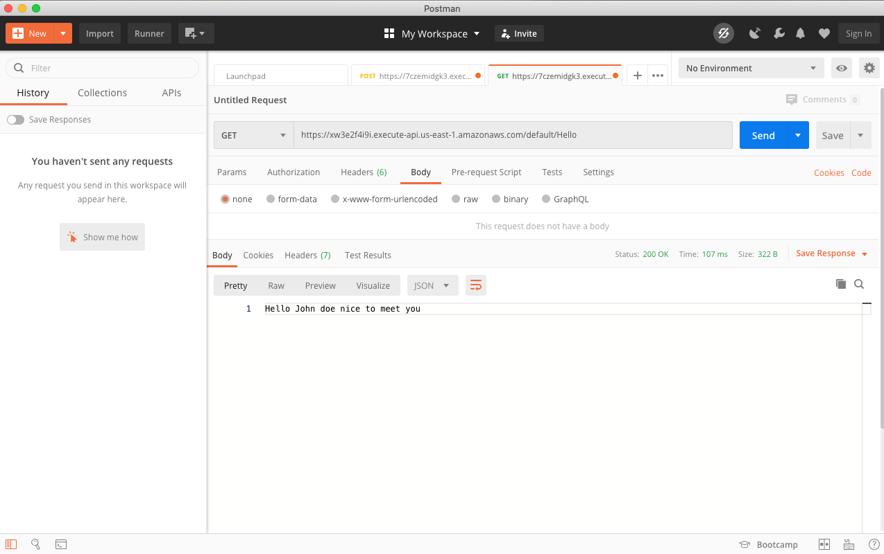
Get A New Name
Download and run Postman
Click Skip Sign In on the bottom
Click + New button on the top left corner
Select Request to create a basic request
Click Cancel to skip the New Collection window
Get the Invocation URL from the API Gateway created in the previous exercise
Paste this URL into the Enter request URL field
Click Send to see the "hello" message from the Lambda

Slide 41
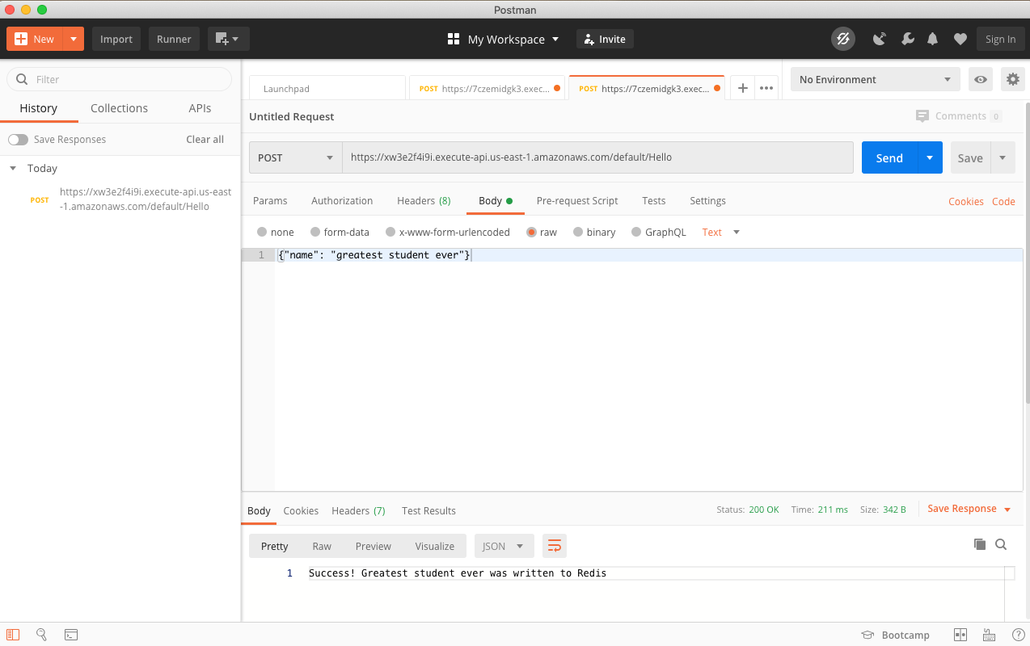
Set a Name
Change the method from GET to POST
Click on Body in the row below the URL
Select Raw
Set the content to:
{"name": "greatest student ever"}

Slide 42

Verify the POST request succeeded by sending another GET request (clear the Body first)

Slide 43
Clean Up
Make sure you delete all of the AWS resources used in this course.
From the ElastiCache console select the Redis instance
  From the Actions dropdown menu, select Delete
From the hello Lambda Function console, click on Delete (next to the API trigger) to delete the API Gateway
From the Actions dropdown menu, select Delete to delete the Lambda Function itself

Slide 44
Further Reading
Tutorials
Build aServerlessWebApplciation
Documentation
AWSServerlessDocumentation
ServerlessApplications Lens – AWS Well-Architected Framework
Books
AWSServerlessComputing For Beginners
Blog Posts
What isserverless
AWSServerlessbold posts

